Slide 1
ECOPS
A simple and efficient cops system

Slide 2
TOC
Overview
Introducing: ECOPS portal
Understanding the problems
Project objective
Product video
Future improvements

Slide 3
Overview
Ecops is a web based application which will be available for every citizen to lodge a complaint and report a crime even when user is in move. At present police department is following manual procedure which takes lot of time and citizen should follow different procedure to file a case, or give information on case which is reducing faith on police department in public. This application uses technology to increase faith of police department in public. Using this application data maintenance, generation of reports, analysis of data, planning and coordination will be fast and easy.

Slide 4
Understanding the problems
01
Citizens in India are not convenient moving around police stations to submit a case because of many reasons like fear, time or ignorance
02
Though lot of filed cases are not investigated due to lack of proper evidences and cooperation of public
03
Absence of proper administration resulted in bribery,and other illegal activities

Slide 5
Crime rate analysis
100%
100%
80%
80%
60%
60%
40%
40%
20%
20%
0%
0%
Q1
Q2
Q3
Q4
Q1
Q2
Q3
Q4
2001
2016

Slide 6
Project objective
Reducing the complexity of the system and maintain the large information of the data.
Maintain the police station creation and have areas of control which can be modified later time through online.
Maintain the criminal information state wise/area wise/age wise through online.
A user can report about an incident/unwanted person.

Slide 7
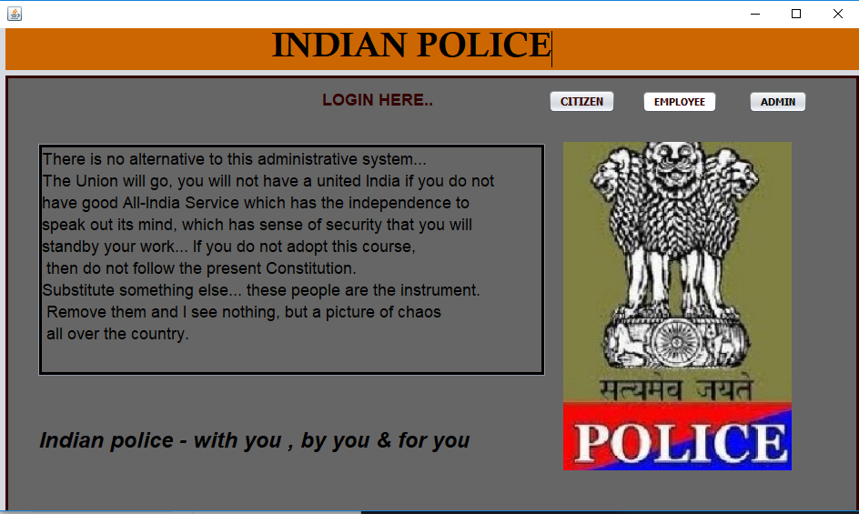
Introducing: Ecops portal
E Cops Project in Java is a web based police management software which is specially designed for police department for managing crime related information. Along with crime management this software can handle human resource related tasks

Slide 8

DIFFERENT modules
Admin Module
Employee module
Citizen module

Slide 9




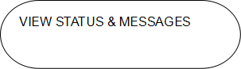

USER abilities

Slide 10
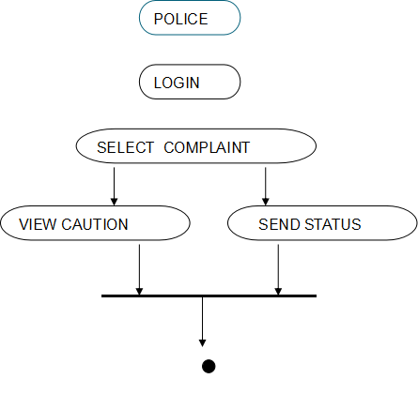
Police abilities

Slide 11

Product video

Slide 12


Improvements
Though we tried our level best there are some features which we could not include because of time constraint
Ability to know case status
Ability to export FIR as a document
Feedback system

Slide 13
Conclusion
Duplication of work is avoided.
Paper work is drastically reduced.
Retrieval and access of data is easy.
Improves efficiency in police department.
Better administration and co-ordination.
Speedy detection of crimes.
Automatic maintenance of registers and reports.

Slide 14

Thank you!
Presented by-
Aruna mallela
Jai kiran
Satwik bhatt

